Slide 1
AACS2192 Analysis and Design of IS – Case Study
Library System

Slide 2
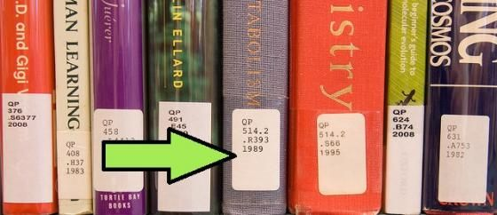
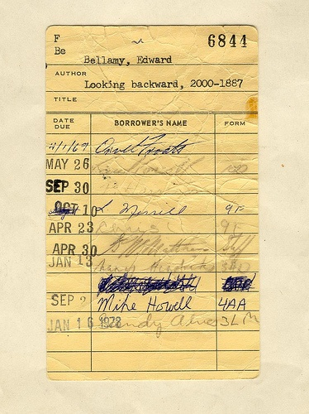
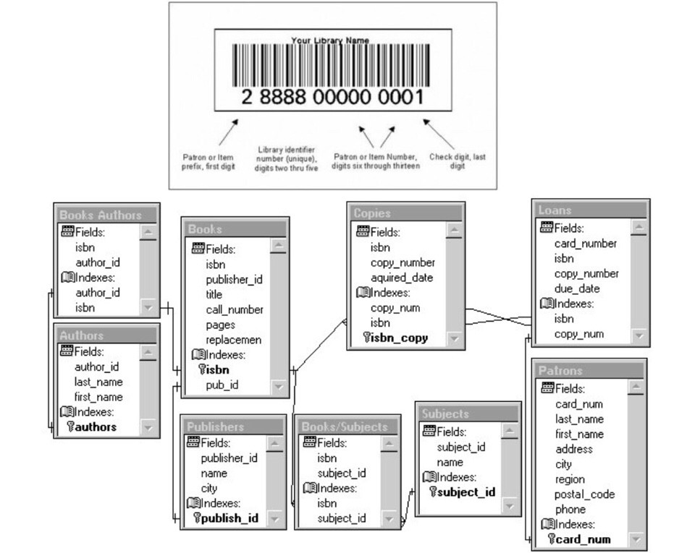
System Planning - System Request
Reasons of System Request
Type of Improvement Requested
Existing System
Improved Performance
Catologing is giving the serial number for each book.
Replace catologing system to barcode system.
Use of barcode system in new borrowing and returning system.
Time-consuming for the members and librarians when finding some books.
New efficiency way of generating report.
Librarians have to count each book and rearrange the serial number for each book.
New account management system.
B
Better Service
A
User's Needs
User friendly cataloging system.
Members have to use library card to borrow and return books
More safety borrowing and returning system.
New account management system with more update.
External Force
Quality Information
Need to keep up with the new advances in technology. Eg. Barcode system
Adequate and accurate catologing system.
Effective borrowing and returning system with details.
Accurate report generating system by computer.

Slide 3
Cost Benefit Summary

Slide 4
Costs
 | YEAR 0 (RM) | YEAR 1 (RM) | YEAR 2 (RM) | YEAR 3 (RM) | YEAR 4 (RM)
Costs:
Hardware | 500,348.90 | 0 | 0 | 0 | 0
Software | 153,052.59 | 95,443.34 | 95,443.34 | 95,443.34 | 95,443.34
Installation cost | 50,762.40 | 0 | 0 | 0 | 0
Operating cost | 12,320.00 | 12,320.00 | 12,320.00 | 12,320.00 | 12,320.00
Development cost | 25,167.60 | 0 | 0 | 0 | 0
Personnel cost | 2,796,000.00 | 2,796,000.00 | 2,796,000.00 | 2,796,000.00 | 2,796,000.00
Total Costs | 3,537,651.49 | 2,903,763.34 | 2,903,763.34 | 2,903,763.34 | 2,903,763.34

Slide 5



Tangible Benefits
Eliminate Overtime
New Library System can do more
RM1,200 * 100 = RM120,000 per
month * 12 = RM 1,440,000.00
Eliminate Additional Position
Replace Additional Position
RM4,000 * 60 = RM240,000 per
Month * 12 = RM 2,880,000.00
Eliminate Daily Error
More Accurate Result
RM60,000 per month * 12 =
RM720,000.00

Slide 6
Cost Benefits Summary
 | YEAR 0 (RM) | YEAR 1 (RM) | YEAR 2 (RM) | YEAR 3 (RM) | YEAR 4 (RM)
Costs:
Hardware | 500,348.90 | 0 | 0 | 0 | 0
Software | 153,052.59 | 95,443.34 | 95,443.34 | 95,443.34 | 95,443.34
Installation cost | 50,762.40 | 0 | 0 | 0 | 0
Operating cost | 12,320.00 | 12,320.00 | 12,320.00 | 12,320.00 | 12,320.00
Development cost | 25,167.60 | 0 | 0 | 0 | 0
Personnel cost | 2,796,000.00 | 2,796,000.00 | 2,796,000.00 | 2,796,000.00 | 2,796,000.00
Total Costs | 3,537,651.49 | 2,903,763.34 | 2,903,763.34 | 2,903,763.34 | 2,903,763.34
Benefits:
Eliminate Overtime | 1,440,000.00 | 1,440,000.00 | 1,440,000.00 | 1,440,000.00 | 1,440,000.00
Eliminate Additional Position | 2,880,000.00 | 2,880,000.00 | 2,880,000.00 | 2,880,000.00 | 2,880,000.00
Eliminate Daily Error | 720,000.00 | 720,000.00 | 720,000.00 | 720,000.00 | 720,000.00
Total Benefits | 5,040,000.00 | 5,040,000.00 | 5,040,000.00 | 5,040,000.00 | 5,040,000.00

Slide 7
Intangible Benefits

Slide 8




Intangible Benefits
Improve Reliability and Security
Improve Library Image
Improve Librarian Morale

Slide 9
Sample Summary of
Questionnaire and Interview

Slide 10
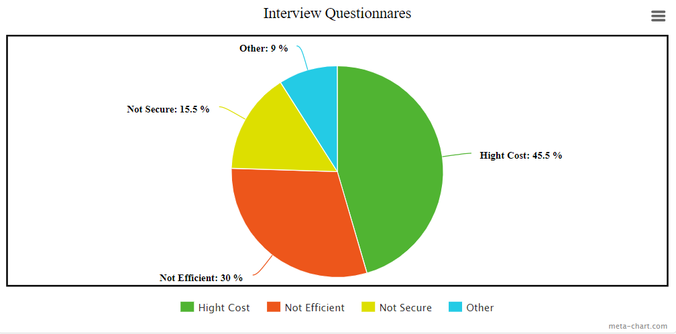
Summary of interview for employee

Slide 11
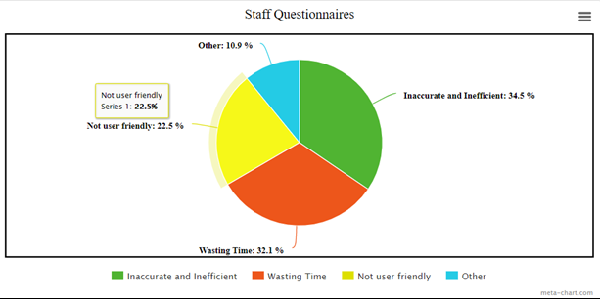
Summary of questionnaires for staff

Slide 12
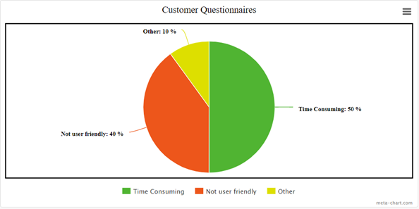
Summary of questionnaires for customer

Slide 13
Functional Diagram

Slide 14
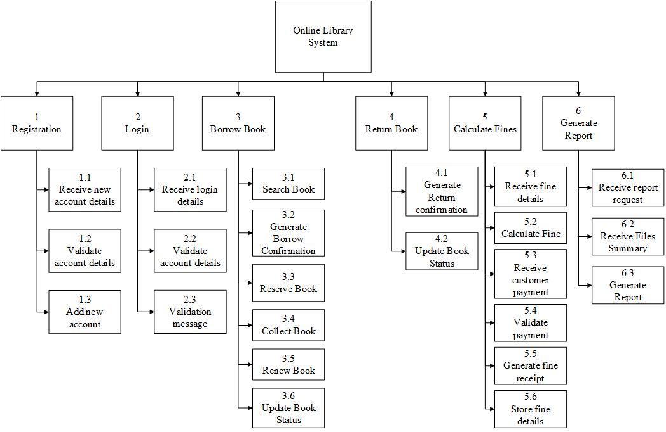
Functional Diagram

Slide 15

Functional Diagram
1 Registration
1.1 Receive new account details
User’s details, account’s registration username, password
1.2 Validate account details
Compare the registration details with the database
1.3 Add new account
Add new account into database

Slide 16

Functional Diagram
2 Login
2.1 Receive account details
Account’s username, password
2.2 Validate account details
Compare the login details with the database
2.3 Validation message
Outputs login confirmation message

Slide 17

Functional Diagram
3 Borrow Book
3.1 Search Book
Search the books inside database
3.2 Generate Borrow Confirmation
Output borrow confirmation message
3.3 Reserve Book
Reserve book on account
3.4 Collect Book
Generate collection date
3.5 Renew Book
Renew return’s date
3.6 Update Book Status
Update book’s file

Slide 18

Functional Diagram
4 Return Book
4.1 Generate Return Confirmation
Output return confirmation message
4.2 Update Book Status
Update Book’s file

Slide 19

Functional Diagram
5 Calculate Fines
5.1 Receive fine details
Receive details from fine file
5.2 Calculate Fine
Calculate with a rate
5.3 Receive customer payment
Request for payment
5.4 Validate Payment
Check with the banks
5.5 Generate fine receipt
Generate digital copy or physical copy
5.6 Store fine details
Update fine details in fine file

Slide 20

Functional Diagram
6 Generate Report
6.1 Receive report request
Receive request from user
6.2 Receive Files Summary
Receive from files
6.3 Generate Report
Generate several report daily

Slide 21

System Design - Inputs

Slide 22

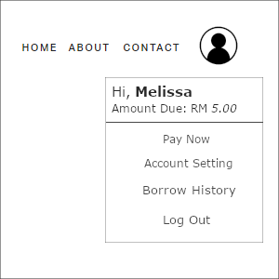

Slide 23
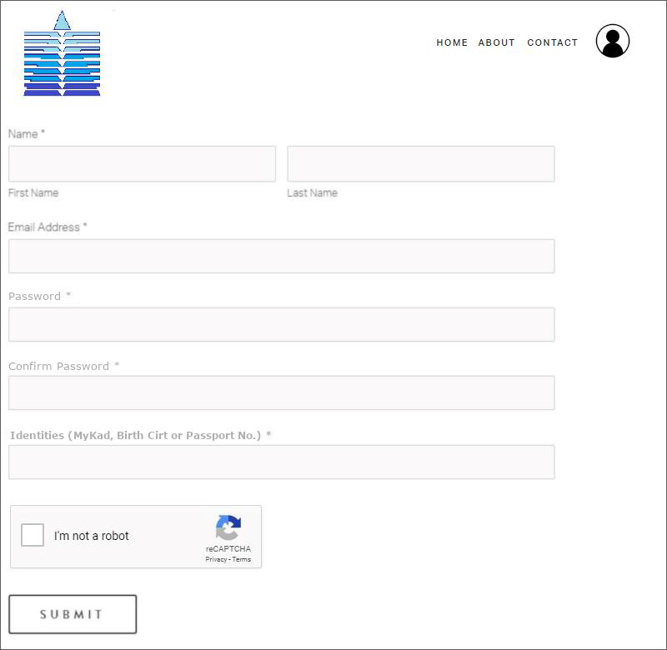
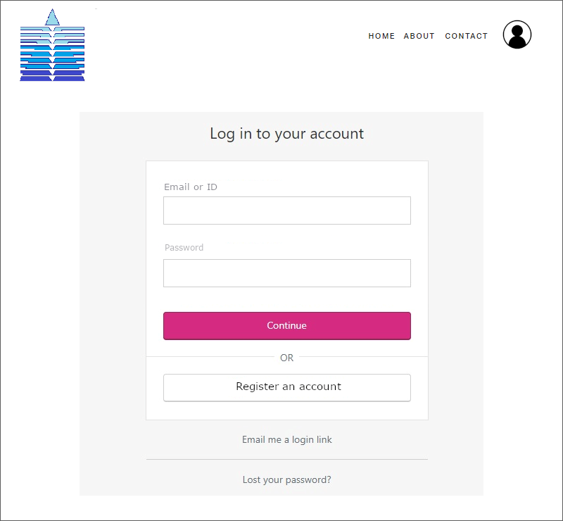
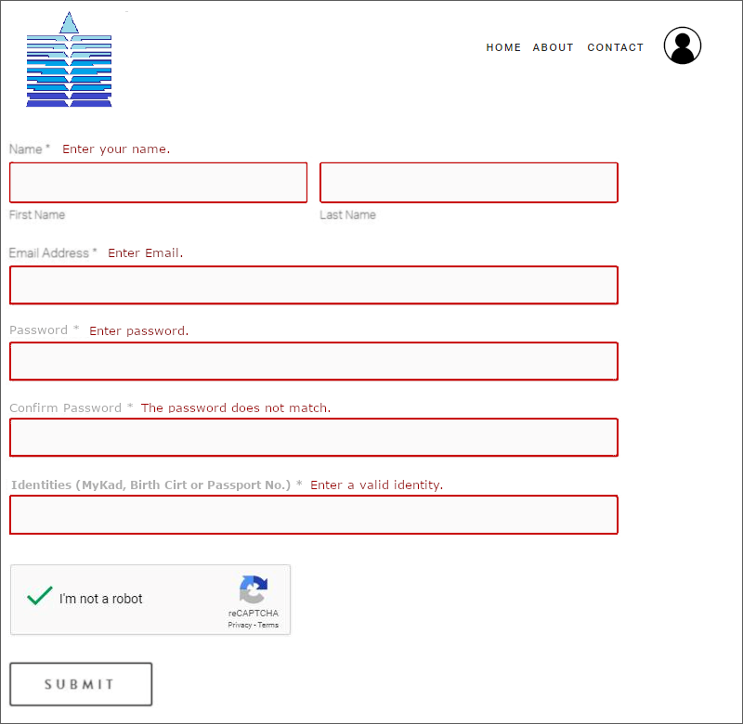
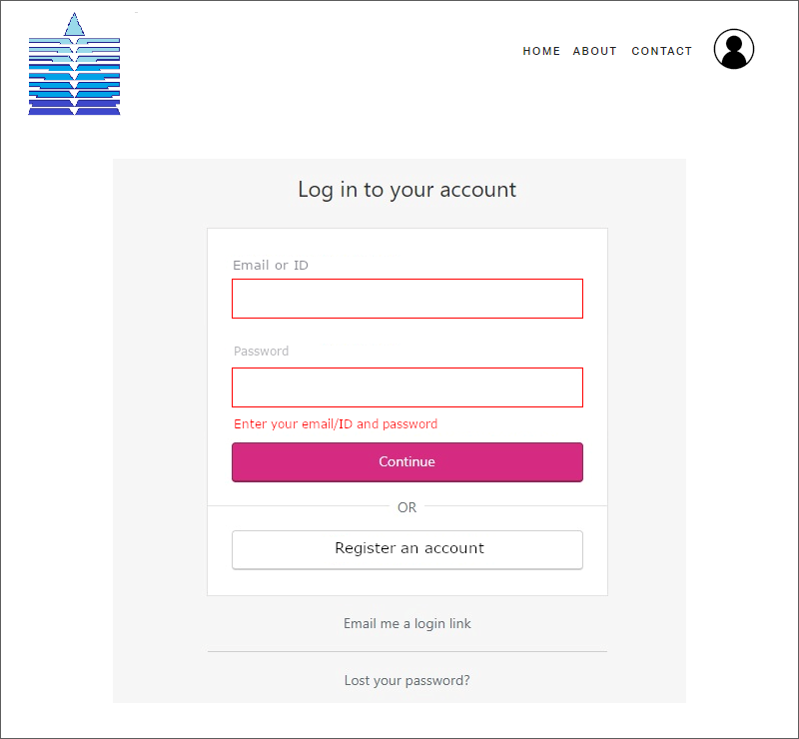
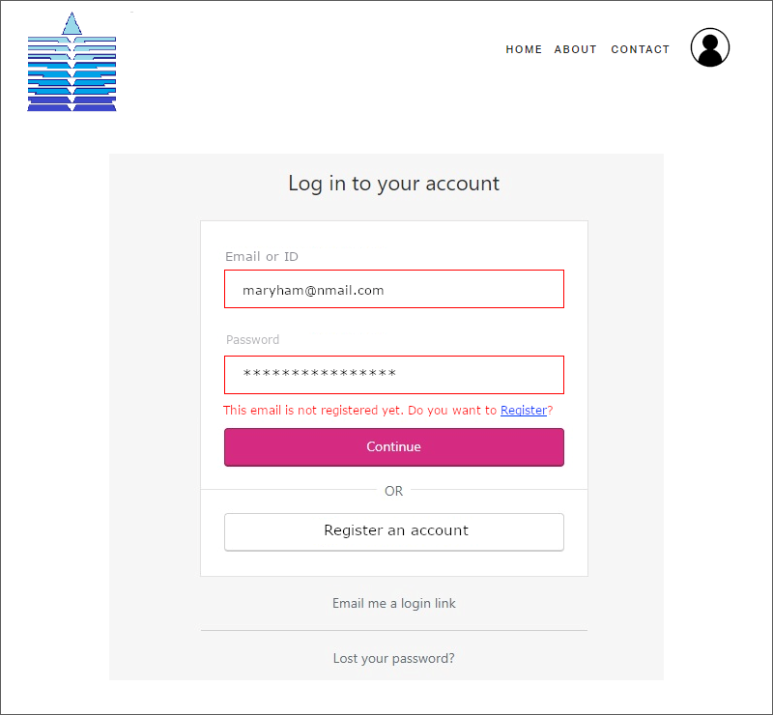
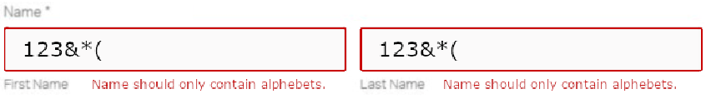





Slide 24
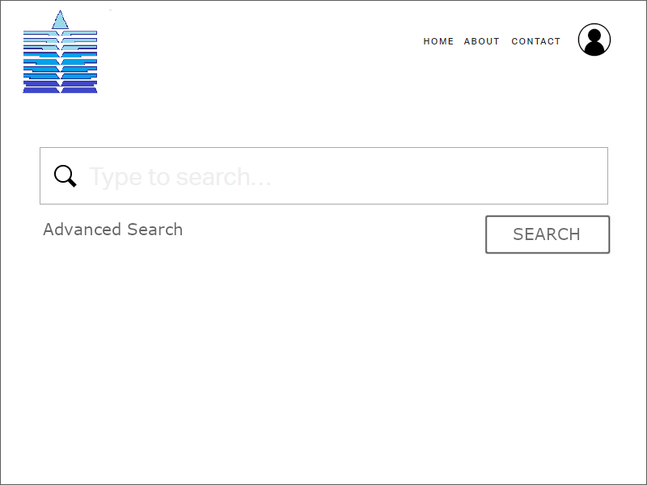

Slide 25
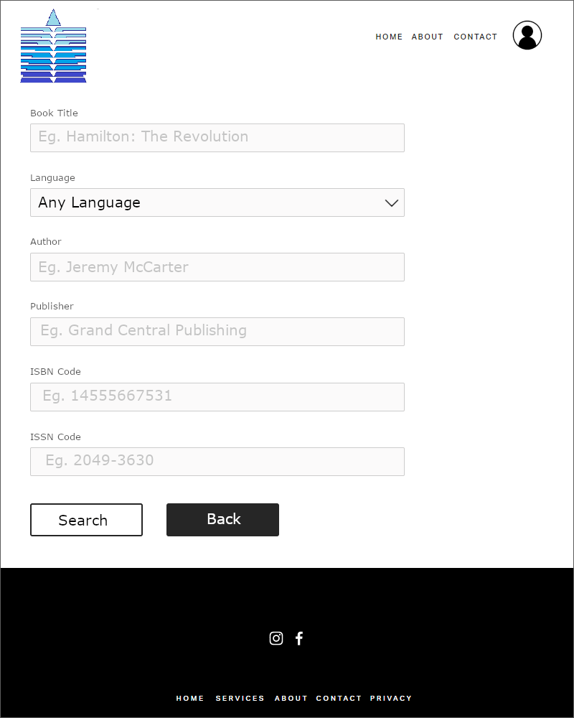

Slide 26
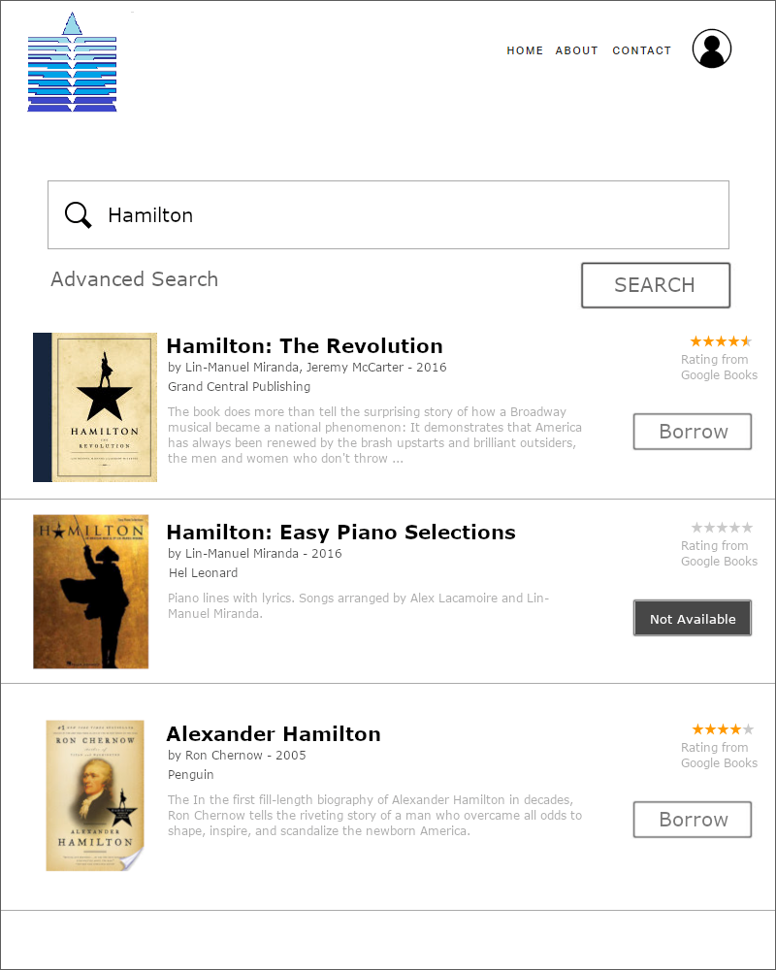

Slide 27
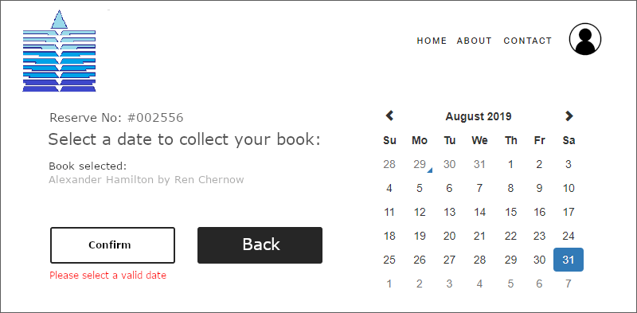
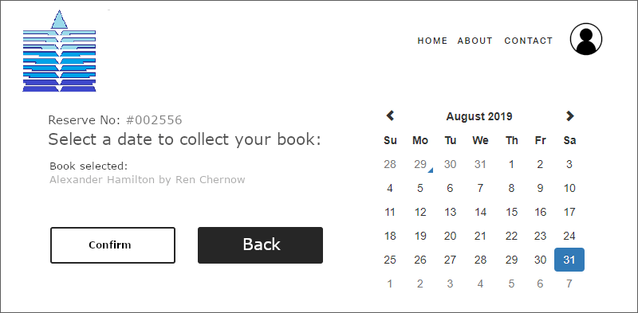
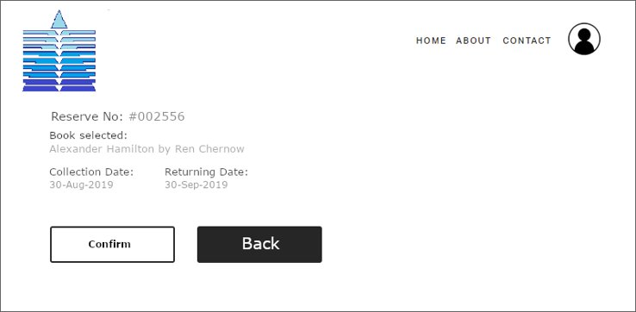

Slide 28
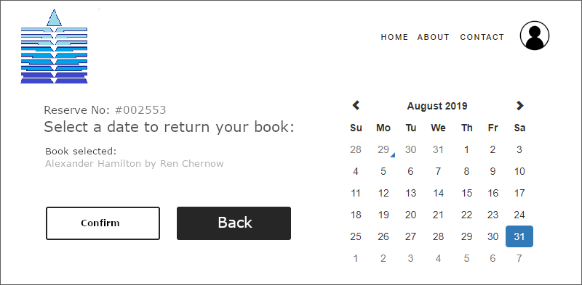
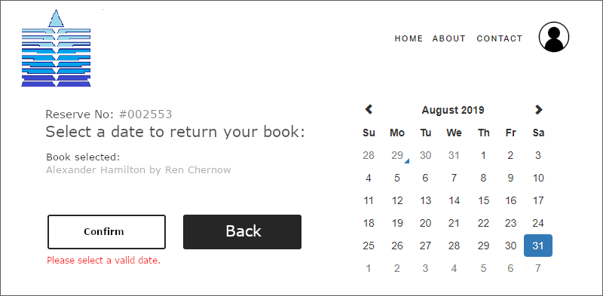
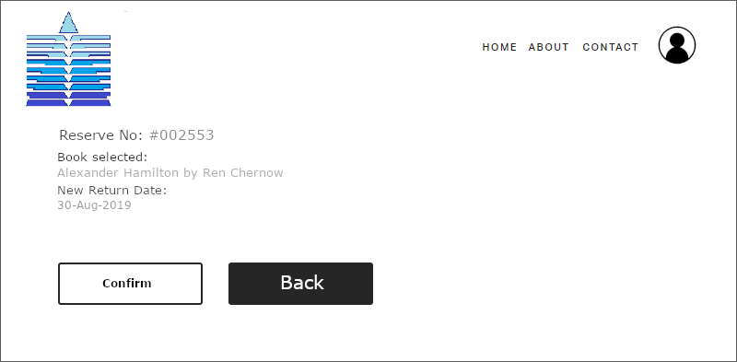

Slide 29
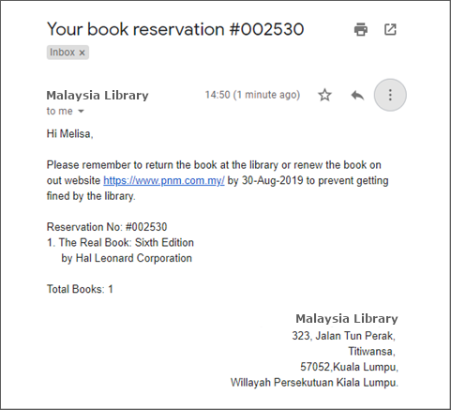

Slide 30
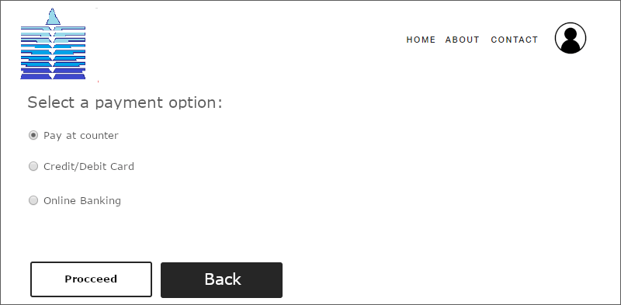
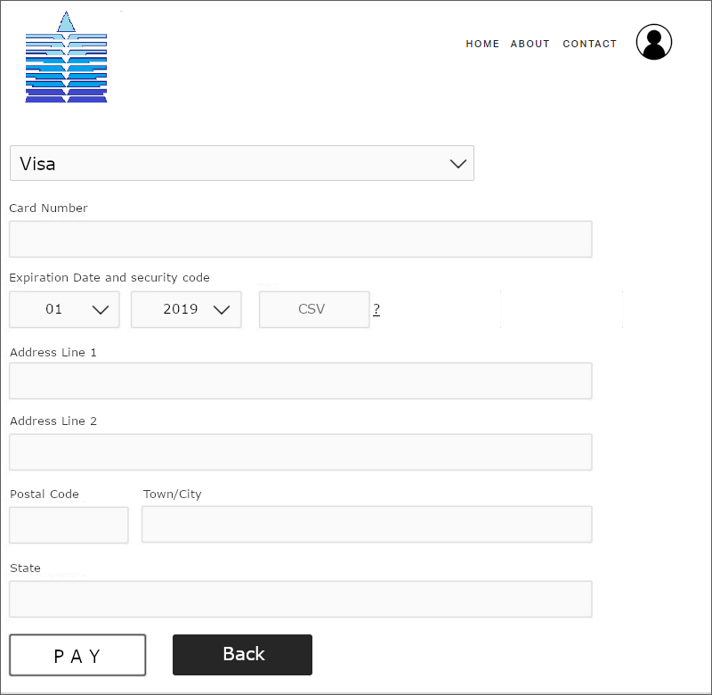
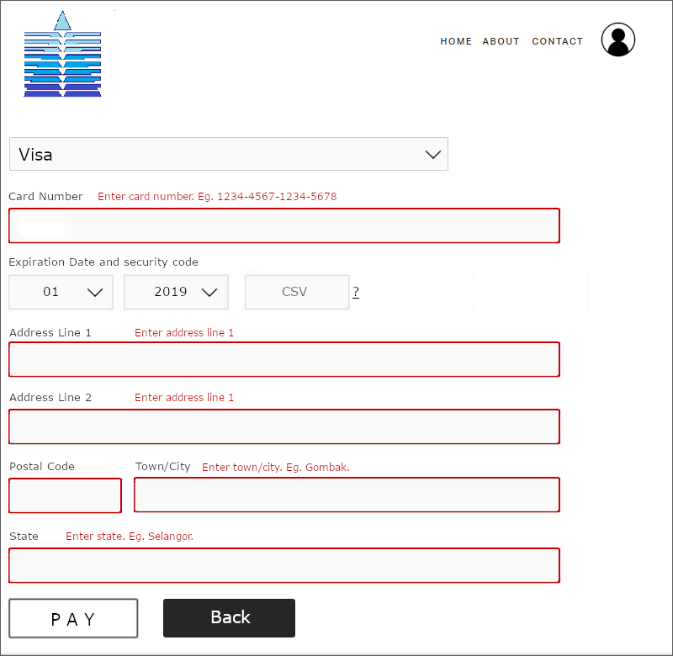



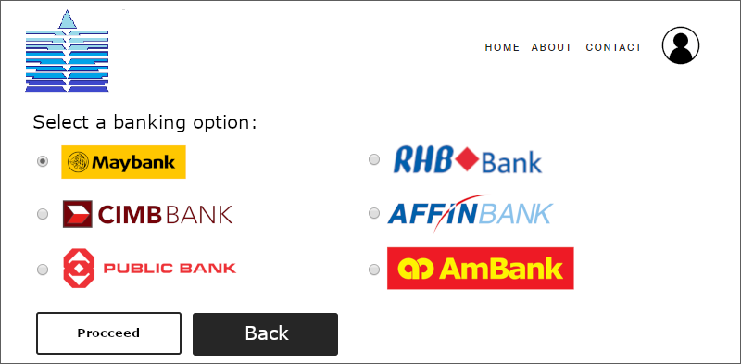

Slide 31
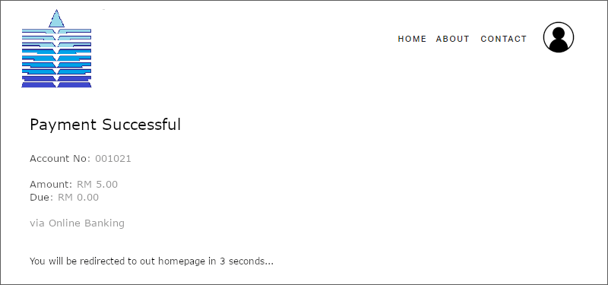

Slide 32
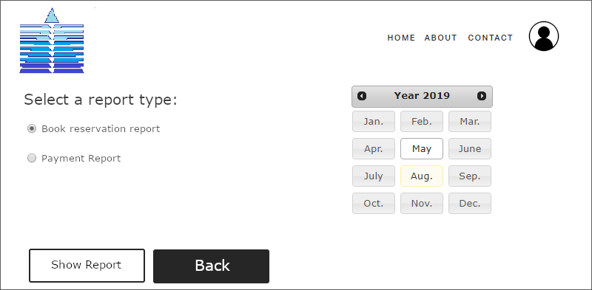

Slide 33

System Design – Outputs / Reports

Slide 34
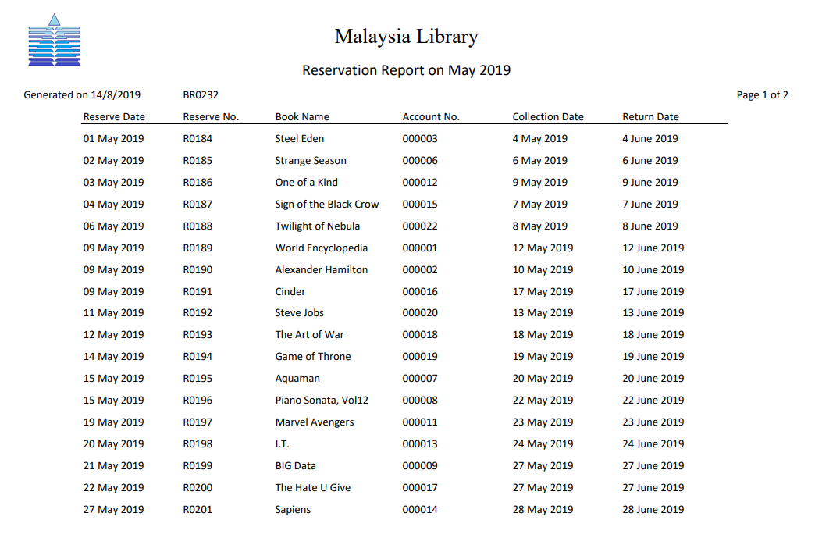
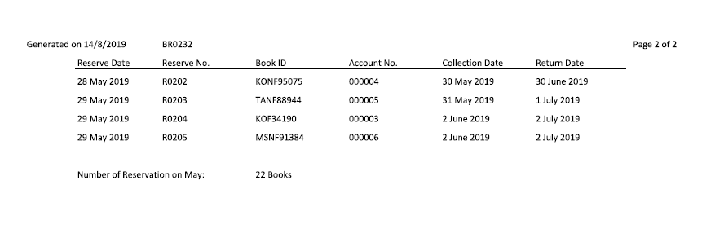
Detail Report
User:
Librarian
Purpose:
To make decision to increase the number of reservation

Slide 35
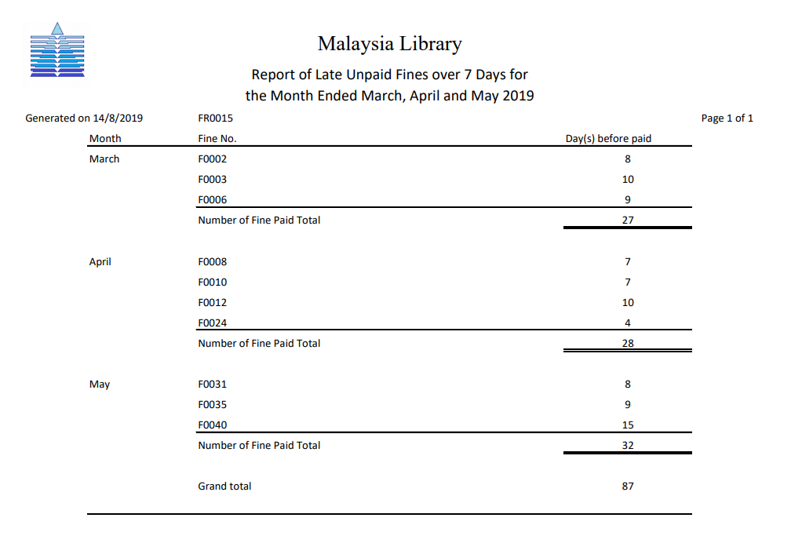
Exception Report
User:
Library Manager
Purpose:
To make decision to make more efforts to decrease the number of days before fine paid overall.

Slide 36
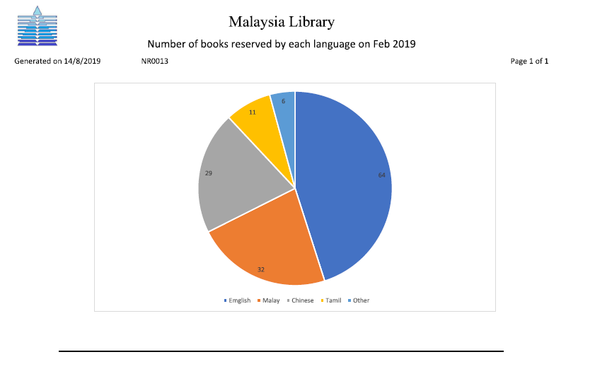
Summary Report
User:
Library Manager
Purpose:
To make sure the number of books can be reserved is adequate.

Slide 37
Principle of Good Report Design
Appropriate Report Title
- Name
- Revision
- Length

Slide 38
Principle of Good Report Design
Pleasing Report Layout
- Lable
- Spacing
- Attractive

Slide 39

Principle of Good Report Design
Meaningful Report Content
- Relevant
- Accuracy
- Title

Slide 40

Principle of Good Report Design
Other
- Ending Line
- Reliable

